Slide 1

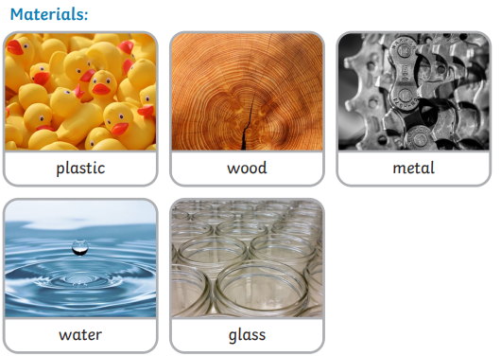

Y
Science Year 1 Spring 1 What materials could we use to make Callum’s new house?
What do I need to know from previous units?
We can use our senses to explore different natural materials. |  | Natural materials are made of things from nature not humans.
What will I know by the end of the unit?
Materials have different physical properties which makes them useful for different things. | We use lots of different materials everyday e.g. metal, plastic, wood and glass.
Materials can be sorted according to their properties E.g. hard, soft, waterproof, rough etc. | Opaque objects can’t be seen through.
Transparent objects can be seen through. Glass is a transparent material. | If something is waterproof, it keeps water out and it keeps things dry.
Key Vocabulary | Definition
Material | Materials are what an object is made from.
Properties | The property of a material is something about it that we can measure, see or feel and helps us decide whether or not it is the best material.
Absorbent | If something is absorbent, it soaks liquid up..
Rough | If something is rough, it feels and looks uneven or bumpy.
Shiny | Reflects light easily.
Waterproof | If something is waterproof, it keeps water out. It keeps things dry.
Dull Transparent | Doesn’t reflect light. Doesn’t look bright or shiny. Transparent objects can be seen through.
Key diagrams:
Key Texts

