Slide 1
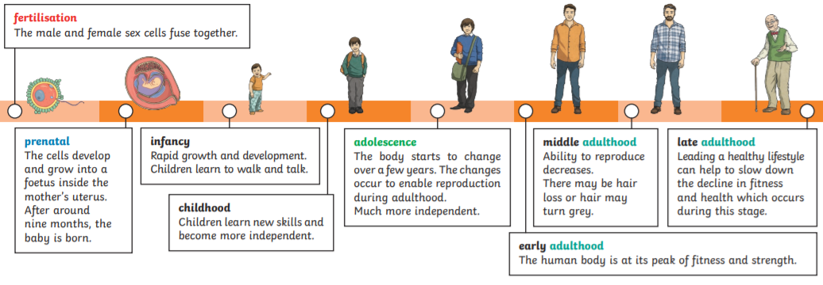
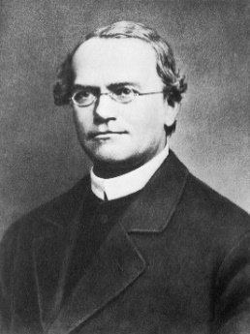
Y
Science Year 5 Autumn 2 How different will you be when you are as old as your grandparents?
What do I need to know from previous topics?
That humans need the right types and amount of nutrition and they get nutrition from what they eat. | Animals grow from offspring into adults.
Key Vocabulary | Definition
puberty | the time when your body begins to develop and change as you move from childhood to adult.
gestation | the time between conception and birth, during which the embryo is developing in the uterus.
fertilisation | the male and female cells fusing together to create an embryo
life expectancy | the length of time, on average, that an animal is expected to live
embryo | an unborn human or animal in the earliest stages of growth when its basic structures are being formed.
adolescence | the body starts to change over a few years to enable reproduction during adulthood.
What will I know by the end of the unit?
All humans go through the same life cycle: they are born, grow older and bigger, some may reproduce and then they die. | The human life cycle begins with an embryo which then develops into a foetus.
Inheritance results in humans sharing physical features with their parents and siblings. | The average human life expectancy is 73 years but this length of time can vary.
If you have a sensible diet and look after your body, you can live healthily into old age. | Children develop into adults during adolescence and become physically capable of reproduction.
Some people need to be cared for and looked after due to physical and mental changes during old age. | The early years, especially the first three years of life, are very important for building the baby's brain
The human gestation period is around 9 months. | The human body goes through important physical changes during early adolescence, this is called puberty.
Key diagram:
Key Texts
‘Can I build another me?’ by Shinsuke Yoshitake
Key people
Gregor Mendel

