Slide 1
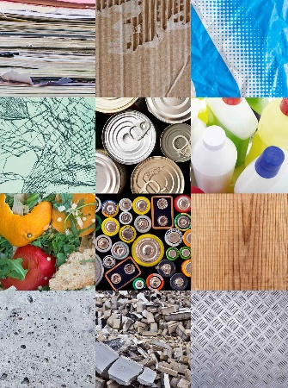
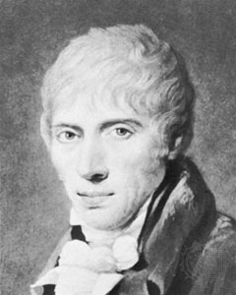
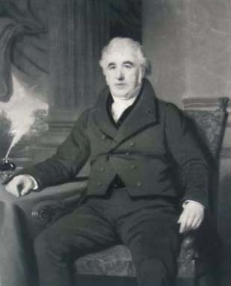
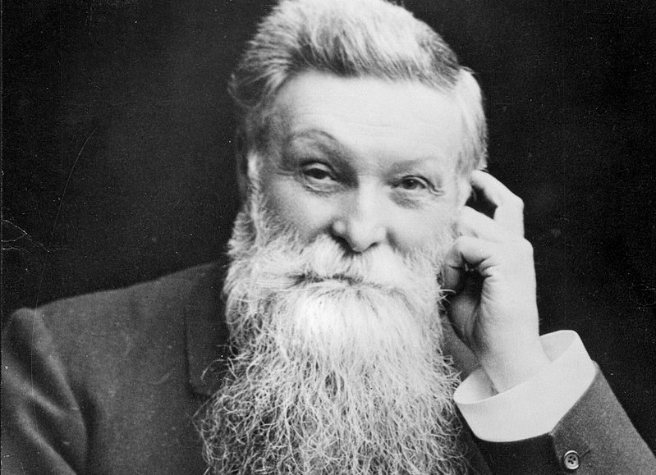
Y
Science Year 2 Autumn 1 and 2 : What is your school made of?
What do I need to know from previous topics?
Glass is often used to make windows and bottles. | Wood is used to make buildings and furniture and for making fires and heating.
Plastics are used to make many of the things we use in everyday life. They are used for toys, bicycle helmets, mobile phones, window frames and many other items use plastic.
Key Vocabulary | Definition
metal | When heated, metals can be shaped into anything from a tiny paperclip to a huge aircraft.
plastic | Plastics are made from natural materials such as wood, coal and oil.
wood | Wood is a material that comes from trees and is used to make furniture, floors and many other things.
squashing | Squashing is pushing things closely together.
bending | Bending is changing the shape and direction of something.
twisting | To twist something you move part clockwise and the other anticlockwise.
stretching | Stretching is making something bigger by pulling it to make it longer.
What will I need to remember for future learning?
Some materials can be changed by squashing, bending, twisting and stretching. | Materials can be natural or man-made.
Plastic is used as it can be made to be flexible, hard, rough or smooth. It is also very cheap to produce and easily washable. | Metal is used as it is strong, hard, smooth and easily washable.
Glass is used as it is strong, hard, smooth, easily washable and transparent.
Key Texts
If I Built A School by Van Dusen
Important People
John Dunlop
Charles Macintosh
John McAdam

