Slide 1
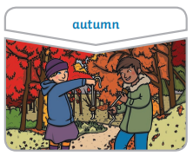
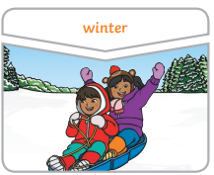
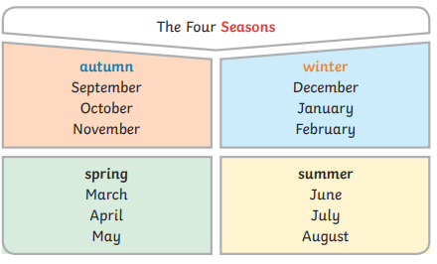
Science Year 1 – Autumn 2 What seasonal changes do you notice from Autumn to Winter?
What do I need to know from previous units?
Use all my senses in hands-on exploration of natural materials. | Understand the effects of changing seasons on the natural world around me.
Key Vocabulary | Definition
Seasons | As the year passes, regular changes occur in the weather. This cycle of weather changes is divided into four parts, known as the seasons.
Autumn | The season when warm summer temperatures gradually decrease to cold of winter.
Winter | The coldest season of the year.
Daytime | The sun shines in the sky and it is light.
Nighttime | When the sun is on the other side of the earth and it is dark.
What will I know by the end of the unit?
There are four seasons each year, autumn, winter, spring and summer. | The weather includes the temperature outside, the wind direction and strength, as well as rain, clod, snow and sun.
In autumn, the weather begins to get colder. The leaves start to fall from the tress. The amount of daylight becomes less. This means the daytimes are shorter and the night times are longer. | In winter, the weather is much colder. Sometimes it is cold enough to freeze, leaving frost and ice on the ground. It sometimes snows. Many trees have bare branches as all their leaves have fallen off. The daytimes are the shortest in the year and the night times are the longest.
Daylight is when it is light outside. The amount of daylight changes with each season.
Key Texts
Tree: Seasons Come, Seasons Go by
P Hegarty and B Teckentrup

