Slide 1
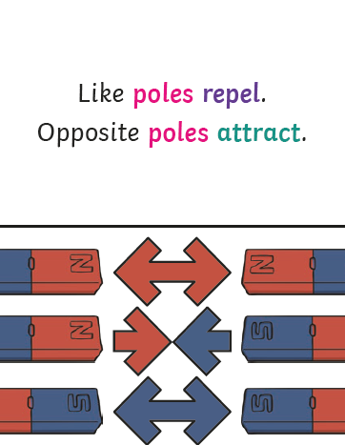
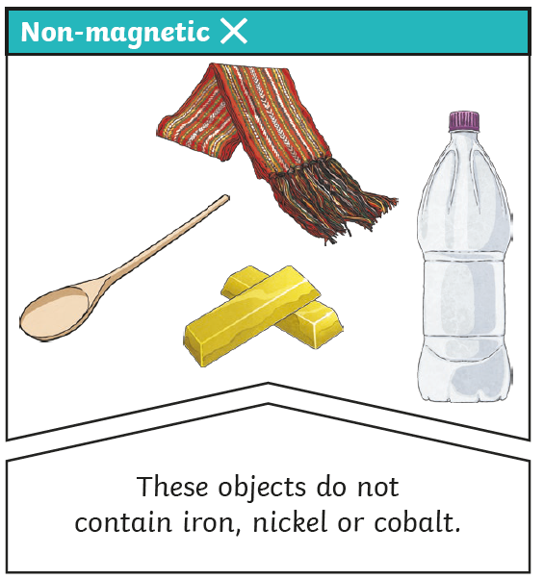
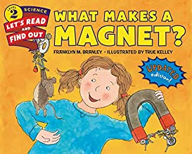
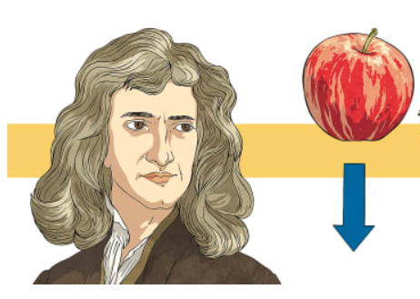
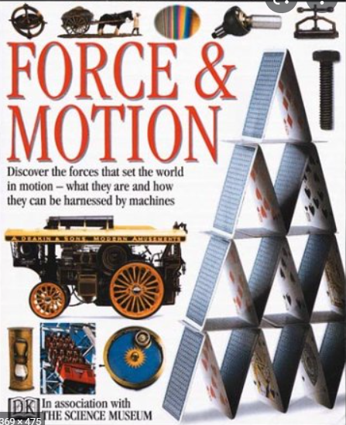
Science Year 3 – Autumn 2 Are you attracted?
What do I need to know from previous units?
There are materials with similar and/or different properties.
Key Vocabulary | Definition
Magnet | An object which produces a magnetic force that pulls certain objects towards it.
Poles | North and South poles are found at different ends of a magnet.
Repel | A force that pushes away.
Attract | A force that pulls objects together.
Forces | Pushes or pulls.
Friction | A force that acts between two surfaces or objects that are moving or trying to move across each other.
What will I know by the end of the unit?
The Earth is a very big magnet. Its North and South poles are highly magnetic. | Some forces need contact between two objects but magnetic forces can act at a distance.
A magnet always has north and south poles. Cutting a magnet in half makes two magnets, each with two poles. | How things move on different surfaces.
Magnets only attract certain types of metals, other materials such as glass, plastic and wood aren't attracted. | How magnets are used in everyday life
Predict whether two magnets will attract or repeal each other. | Isaac Newton was a British scientist working over 300 years ago. He worked out some important science that is now called the laws of gravity.
Key diagrams
Scientists Isaac Newton
Key Texts
What makes a magnet?
Force and Motion

