Slide 1
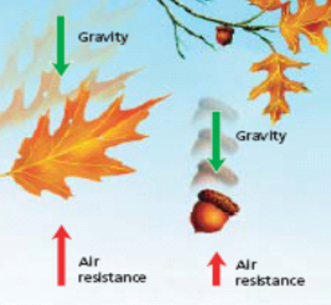
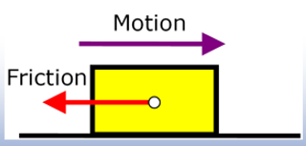
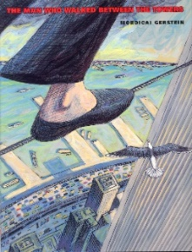
Science Year 5 Autumn 1 Can you feel the force?
Y
What do I need to know from previous topics?
Spot a pattern between how much force is applied and how far an object moves. | Use arrows to show forces acting in scientific diagrams.
Explain how the greater the friction, the more force Know some forces need contact, but magnetism is needed to move something. and gravity are non-contact force.
Key Vocabulary | Definition
friction | a force between two surfaces that are sliding, or trying to slide, across each other.
gravity | a force which tries to pull two objects toward each other.
air resistance | a type of friction between air and another material.
water resistance | a type of friction between water and another material.
mass | how much ‘stuff’ is inside an object. It remains constant and is measured in kilograms.
weight | The force of gravity on an object. It changes depending on gravity and is measured in Newtons.
What will I know by the end of the unit?
Frictional force is any force that is caused due to friction. An example of this might be when you put on the brakes on your bike. | Water resistance is the force on objects floating on or moving in water.
Gravity is the pulling force acting between the Earth and a falling object, for example when you drop something. Gravity pulls objects to the ground. | Know that the shape of an object determines how much air or water resistance it experiences.
Surface resistance is the force on objects moving across a surface, such as an ice-skater skating on ice. | Recognise that some mechanisms (levers, pulleys and gears) allow a smaller force to have a greater effect
Any kind of force is really just a push or a pull. | Isaac Newton is said to have discovered gravity when an apple fell from a tree and he questioned how and why it falls.
Air resistance is the force on an object moving through air, such as a plane moving through the sky. | Forces are measured in units called Newtons.
Key diagrams
Key Texts
‘The Man who Walked Between the Towers’ by Mordicai Gerstein
Key people
Isaac Newton
Galileo Galilei

