Slide 1
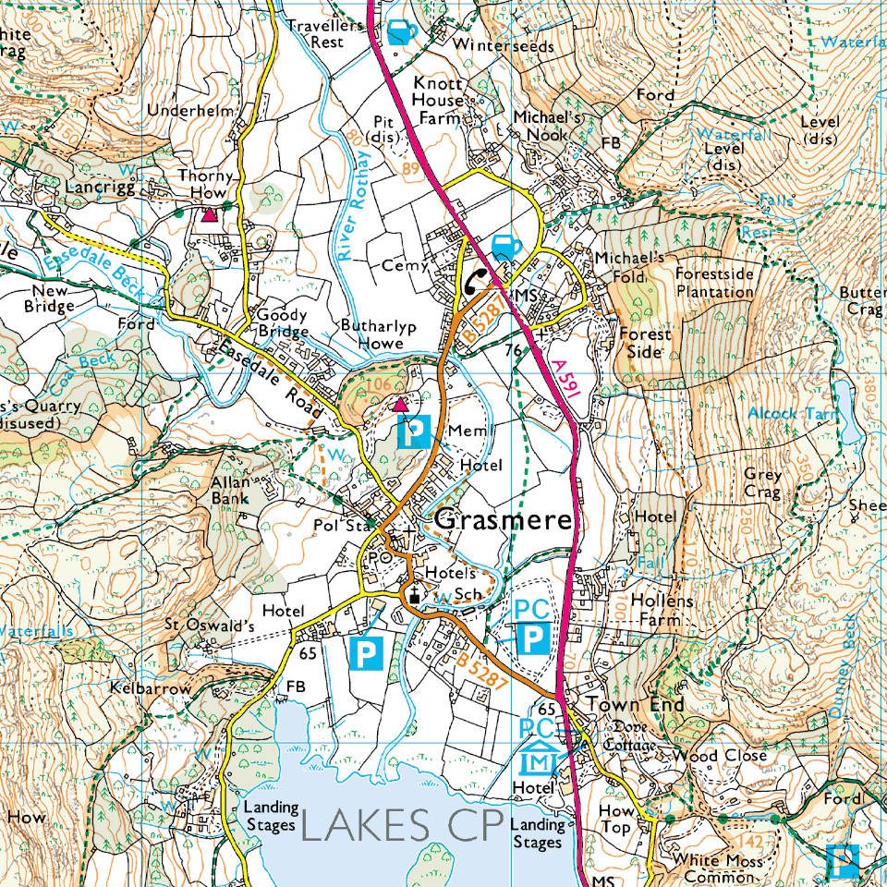
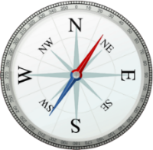

Where do maps take us?
How do we find information in an atlas?
Why do maps have symbols on them?
What is a compass and how does it work?
How can co-ordinates help us to find our way?
Can we plan a route using our map skills?
What can maps tell us about how our area has changed over time?
Can we use maps to locate other cities around the world?
What can we find out about the USA using a map?
Key texts:
Instructions for entering a fantasy world
Neil Gaiman
Vocabulary:
*Ordnance *compass *coordinates
*North *South *East
*West *atlas *Country
*City *Capital *Continent
*grid reference *human
*physical *hemisphere
*symbol *urban *key
*population *landmark *route
*location *local area *environment
*longitude *latitude
We learn the following geographical knowledge and skills…
Use maps, atlases and computer mapping (Google Earth)to locate countries and describe features studied (all questions)
Find information in an atlas using the index and simple co-ordinates (1)
Use a key to describe the symbols on an Ordnance Survey map (2)
Locate large urban areas on a map and use symbols e.g. contours to identify flat and hilly areas (2)
Use the eight compass points to describe a route on a map (3)
Use four and six figure grid references to locate places on a map in our local area and around the world (e.g. main mountain ranges, longest rivers)(4,7)
Plan a journey using the eight points of a compass and four and six figure grid references (5)
Use fieldwork to observe and measure human and physical features in our local area by surveying the land (outdoor activity) (6)
Study maps of UK locations and identify how land was used in the past, how and why is has changed and how it may continue to change. (6)
Study maps of the USA to identify and compare environmental regions (8)
Locate the key physical and human characteristics on a map and relate these to a locality e.g. population sizes near tourist landmarks, transport links to mountains (8)
How do maps impact on our lives today?
Following a map to find a new place and plan a route
Use the points on a compass
Know some key symbols on maps and signs when out in the local environment
Know how to use a map, coordinates and a key
Cross Curricular links:
Maths: co-ordinates, time zones, measuring distances and using scales on a map, compass points for position and direction
English: Create a map with instructions
Imperative verbs, conjunctions, expanded noun phrases, sequential language, adverbs

