Slide 1
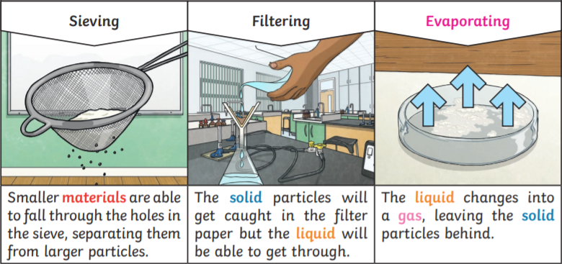
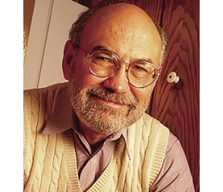
Y
Science Year 5 Spring 1 and 2 Could you be the next chemistry inventor?
What will I know by the end of the unit?
Some materials can be changed by squashing, bending, twisting and stretching. | Materials can be natural or man-made.
What will I know by the end of the unit?
Materials that will dissolve are known as soluble. Materials that won't dissolve are insoluble. | Irreversible changes, like burning, cannot be undone.
Dissolving occurs when the particles of certain solids mix with the particles of certain liquids. | Mixtures can be separated out by methods like filtering and evaporating.
Heat can travel easily through thermal conductors. Metals are good thermal conductors, as they allow heat to move through them. | Not all solids will dissolve, and not all liquids will allow solids to dissolve.
Thermal insulators do not let heat travel through them easily. Some fabrics, wood and plastics are good thermal insulators. | Melting, freezing, evaporating, condensing and dissolving are examples of reversible physical changes.
Heat always travels from a warmer area to a cooler one. | Spencer Silver’s accidental discovery resulted in the invention of the Post-It Note.
Key Vocabulary | Definition
property | the quality or characteristic of a material. For example, strong or flexible
dissolve | when a soluble solid mixes with liquid so completely that it will disappear
soluble | able to be dissolved, especially in water
insoluble | does not dissolve in water
ssieving | used to separate insoluble solids
ffiltering | used to separate an insoluble solid from a solution
evaporating | turn from liquid into vapour
reversible | a change that can be reversed – you can get back what you started with
irreversible | a change is permanent – new substances are made and you can't get the original ones back
Key diagrams
Key Texts
Snackable Science Experiments: 60 Edible Tests to Try and Taste – Vanstone
Key people
Spencer Silver

