Slide 1
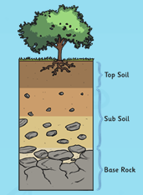
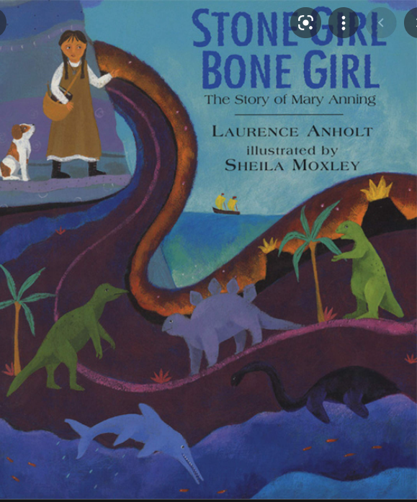
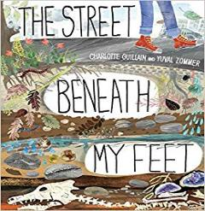
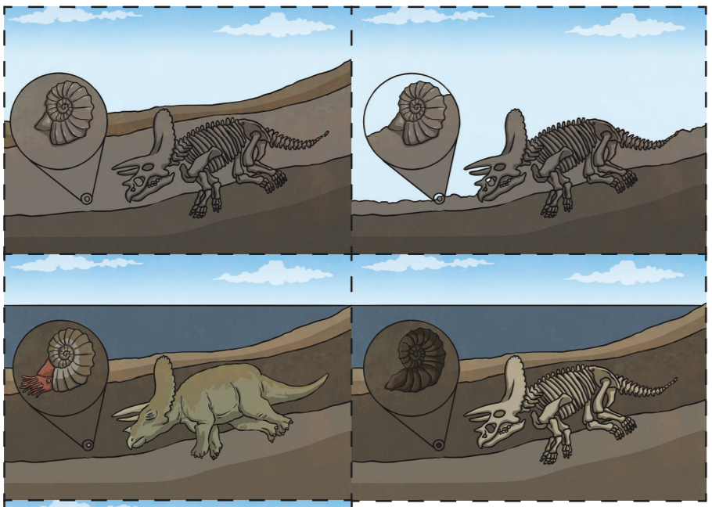
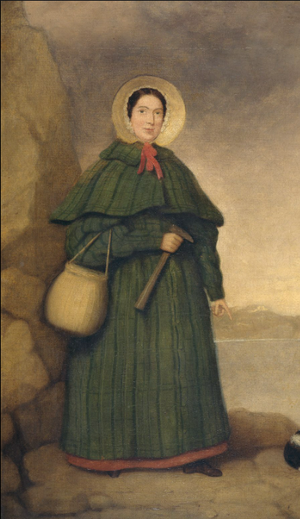
Science Year 3 – Autumn term 1 What do rocks tell us about the way the Earth was formed?
What do I need to know from previous topics?
Spot a pattern between how much force is applied and how far an object moves.
Use arrows to show forces acting in scientific diagrams.
Explain how the greater the friction, the more force Know some forces need contact, but magnetism
is needed to move something. and gravity are non-contact force.
What do I need to know from previous topics?
Compared different materials including rock and thought about what they are used for. | Explained how the shape of some solid objects can be changed by squashing, bending, twisting and stretching.
Explained how different materials are suitable for a particular purpose.
Key Vocabulary | Definition
fossil | A fossil is the preserved remains or traces of a dead organism.
soil | Soil consists of a mix of organic material (decayed plants and animals) and broken bits of rocks and minerals.
sedimentary | Sedimentary rocks are made when sand, mud and pebbles get laid down in layers. Over time, these layers are squashed under more and more layers.
metamorphic | When a rock experiences heat and pressure, it becomes a metamorphic rock. All metamorphic rocks start as another type of rock.
igneous | Igneous rock is formed when magma cools and solidifies, it may do this above or below the Earth's surface.
organic matter | Organic matter is matter that has come from a recently living organism. It is capable of decaying.
What will I know by the end of the unit?
Sediment deposited over time, often as layers at the bottom of lakes and oceans, forms sedimentary rocks. | Mary Anning was a famous fossil collector. She discovered the first ichthyosaur fossil in 1811 when she was only 12 years old.
Extreme pressure and heat over time forms metamorphic rocks. Examples are marble and slate. | Rocks have different masses. Some are very heavy like granite and some are very light like pumice.
When magma cools and solidifies it forms igneous rock. Examples are granite and pumice. | Humans can make rocks. The Romans first used concrete. Concrete is a mixture of water, stones and cement.
Rocks have been used by humans for millions of years, from early tools and weapons through to various construction materials. | Soil contains organic material(decaying plants and animals). Many creatures can be found in soils. Worms make passages in the soil that helps plants to grow.
Key diagrams Fossil
Formation Soil Layers
Scientists - Fossil Collector
Mary Anning
Key Texts

