Slide 1
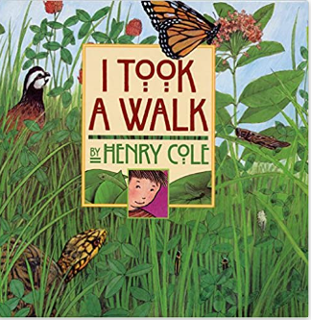
Y
Science Year 2 – Spring 1: How can we look after this?
What do I need to know from previous units?
To understand the need to respect and care for the natural environment and all living things. | When making observations of animals and plants, be able to explain why some things occur, and talk about changes.
What will I know by the end of the unit?
There are things that all living things can do. They move, breathe, sense, grow, make babies, get rid of waste and get their energy from food. | A habitat provides living things with everything they need to survive such as food, shelter and water.
A microhabitat is a very small habitat in places like under a rock, under leaves or on a branch. Minibeasts live in microhabitats. The microhabitats have everything they need to survive. | Food chains are one of the ways that living things depend on each other to stay alive.
Key Vocabulary | Definition
Respiration | The action of breathing.
Reproduction | The production of off spring (babies).
Excretion | The process of getting rid of material such as solid waste or urine from the body.
Nutrition | The process of providing or obtaining the food necessary for health and growth.
Adapt | Become adjusted to new conditions.
Habitat | A habitat is the natural place something lives.
Microhabitat | A small area which differs in some way from the surrounding habitat.
Life processes | These are the things that all living things do.
Living | Things that are living have all the life processes.
Dead | Things that are dead were once living. They did have all the life processes but don’t now.
Never living | Things made out of metal, plastic or rock were never living. They never had the life processes.
Food chain | A food chain shows how each animals gets its food.
Depend | Many living things in a habitat depend on each other. This means they need each other for different things.
Survive | To survive means to stay alive.
Key Texts
I took a walk
by
Henry Cole

